Slide 1


SEICHE 2022 Basic Arduino Programming
Instructor: Paul Frommeyer
www.paulfrommeyer.com
Corporate Sponsor: DXC Technology

Slide 2
Lesson Plan Overview
Lesson 1 – Intro and Setup [may require 2 classes]
Introduction to class format
Overview of lesson plan
Presentation format (monitor, camera, screen, whiteboard)
Review of microcontrollers and types of boards
SEICHE LED display architecture
ESP8266 pinout
High level architecture
Lesson 2 – Laptop operation review – Windows and Linux
Inventory of USB drives
Installation of Arduino IDE software
Installation of CH340/ESP8266 serial port drivers (Windows only)
Control panel/settings location
Home directories and folder hierarchy
Arduino file locations
Search functions
(Windows) Device Manager
(Linux) Konsole
Copying flash drive contents [critical]
Open questions and issues
IDE essentials
Starting the Arduino IDE
Basic Arduino sketch (program) structure
Loading example sketches
Loading and configuring new boards
Connecting boards
Identifying the microcontroller serial port
Linux
Windows
Lesson 3 – Libraries, Sketch structure, Serial Monitor, Variables, Binary Number System Pt1
Libraries
Sketch structure (A note on brace formatting)
The serial port monitor
Printing to the serial port monitor
Variables and the assignment operator
Binary number system Pt. 1.
Lesson 4/5 – The Binary Number System Cont. (may take 2-3 lessons)
Numerals vs numbers
Review: the base 10 system and digit place values
New: the base 2 system and digit place values
Bits and bytes and nybbles
Binary addition and subtraction
Formatting printed output
Shifting and exponents
Lesson 6/7 – Integers and Arithmetic Operators (may take 2 lessons)
The integer data type
Variables and the assignment operator
Autoincrement and autodecrement
Arithmetic Operators
Assigning arithmetic results to a variable
Bytes as data types
Lesson 8 – Communicating with Sensors
Reading a potentiometer
Reading a button
Initializing I2C sensors
Reading I2C sensors
Lesson 9 – Characters and Arrays
The hexadecimal number system
Representing characters as numbers
The ASCII character code
The char data type
Strings and character arrays
Lesson 10 – Comparison Operators
==, =>, <=
strcmp
Binary comparisons
Uploading a sketch to the microcontroller
Lesson 11 – Control Structures
if-then-else
while
for-next
Lesson 12 – Programming the LED matrix
Initializing the SPI interface
Controlling display brightness
Lighting and clearing a single pixel
Displaying text on the LED matrix
Default fonts
Nested for-next loops

Slide 3
Lesson 3 – Libraries, Sketches Serial Monitor, Variables, Binary Numbers
Part A
Libraries and the Library Manager
Sketch Structure
Setup and Loop
The parts of a program (sketch): values, statements, functions
The serial port monitor
Printing to the serial port monitor
Part B
Data types in detail: bytes, integers
Variables
Assigning values to variables
Printing variables
Simple arithmetic operators
Part C [Time permitting]
Introduction to the binary number system

Slide 4
The Library Manager
A library is a collection of software written by others which performs a specific function or related functions
Libraries allow us to use code written by others in our own projects
In the Arduino IDE, the Library Manager handles the selection and installation of libraries
Libraries are board-specific, so you must have the proper board definition(s) installed first, before you can install libraries for that board
The Library manager is accessed from the Sketch menu
Let’s make sure everything is set up correctly for our Wemos D1 Mini board with its ESP8266 microprocessor…

Slide 5
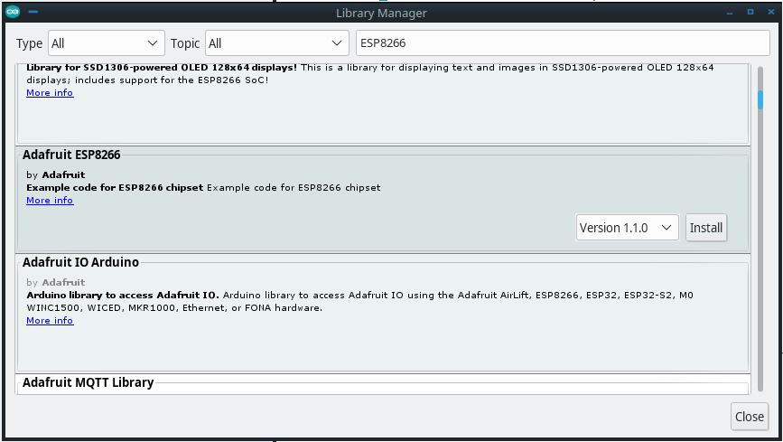
Library Manager – ESP8266
ADD A LIBRARY
Open “Manage Libraries” under “Include Library” in Sketch menu
Enter “ESP266” in seach box
Install the Adafruit ESP8266 library

Slide 6
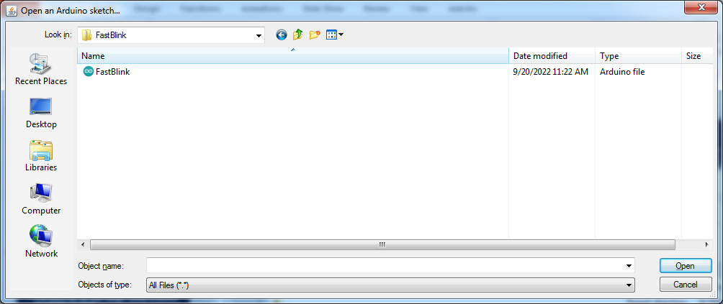
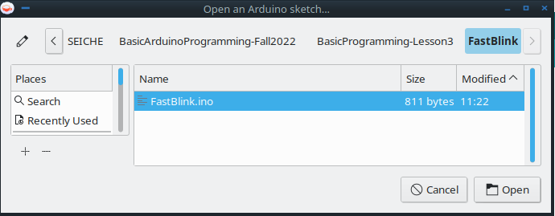
Let’s load our own sketch!
Windows
File menu->Open
Navigate to the“FastBlink.ino” file in the Lesson3->FastBlink folder you copied from your USB drive at the beginning of class
The sketch will open in the IDE
Click on the “UPLOAD” arrow icon
Once compile and upload are finished, the sketch will immediately run
You should see your blue LEDs blink twice
Kubuntu
Note
Sketches live in folders with the same name

Slide 7
Lessons 1-3 Skills Review
At this point you should now be able to:
Connect your ESP8266 Wemos D1 Mini board to your computer
Have the computer recognize the board
Identify the board serial port (Device Manager if Windows)
Start the Arduino IDE
Configure and install the board type in the Board Manager
Configure and install a matching library in the Library Manager
Select the serial port and port speed in the IDE
Load an example sketch or your own sketch
Validate (compile) a sketch
Upload a sketch to your board
You can now start experimenting with different sketches from the IDE examples!

Slide 8
Parts of an Arduino Sketch
All sketches have two main parts, or sections, of C++ code
A setup section that runs once when the microcontroller is powered up or reset. This is why a reset (automatically) happens after a sketch is first loaded.
A loop section which runs continuously after the setup section has completed
Technically speaking, these sections are individual functions and are called by a master code module which the Arduino IDE elides (hides) from the user
Setup is used to initialize variables, set pin operating modes, and other things to “set the stage” for the main program loop
The loop is where the program steps (statements) for actual processing and events take place
Certain special code may go outside of the setup or loop

Slide 9
Anatomy of a sketch
Constants are one type of data defined outside the setup and loop sections
const byte LED_RED = 13;
const byte LED_GREEN = 12;
const byte LED_BLUE = 14;
// the setup function runs once when you press reset or power the board
void setup() {
// initialize digital pins as outputs.
pinMode(LED_RED, OUTPUT);
pinMode(LED_GREEN, OUTPUT);
pinMode(LED_BLUE, OUTPUT);
}
// the loop function runs over and over again forever
void loop() {
digitalWrite(LED_RED, HIGH); // turn the LED on (HIGH is the voltage level)
delay(1000); // wait for a second
digitalWrite(LED_RED, LOW); // turn the LED off by making the voltage LOW
delay(1000); // wait for a second
digitalWrite(LED_GREEN, HIGH); // turn the LED on (HIGH is the voltage level)
delay(1000); // wait for a second
digitalWrite(LED_GREEN, LOW); // turn the LED off by making the voltage LOW
delay(1000); // wait for a second
digitalWrite(LED_BLUE, HIGH); // turn the LED on (HIGH is the voltage level)
delay(1000); // wait for a second
digitalWrite(LED_BLUE, LOW); // turn the LED off by making the voltage LOW
delay(1000); // wait for a second
}
Here is the Setup section
This is the Loop section

Slide 10
The serial port monitor
It is possible to receive output from the microcontroller without having anything connected to it. The tool used to do this is called the Serial Port Monitor. Let’s see how that works!
Create a blank sketch (File -> New) and enter the following code:
Serial.begin(9600);
Serial.println(“Hello world!”);
Your resulting sketch should look like this:
void setup() {
// put your setup code here, to run once:
Serial.begin(9600);
Serial.println("Hello world!");
}
void loop() {
// put your main code here, to run repeatedly:
}

Slide 11
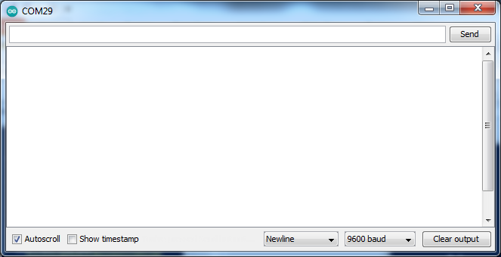
The serial port monitor
Now, BEFORE uploading the sketch, open the Serial Port Monitor (Tools->Serial Monitor)
At the bottom, use the pop-up menu to set the monitor speed to 9600 baud
Reselect the new sketch window
NOW you can upload the sketch! (And should!)
You will be asked to save the sketch; call it anything you like

Slide 12
C++ Data Types
There are many different ways in which data is stored in the C++ language
A data type is a particular method for organizing and storing data
All computer data is stored as some form of binary information– all 1’s and 0’s. This is because the transistors that our computers are built on can only be either on (one) or off (zero).
Data types are designed as an aid to processing and displaying particular types of data
The simplest data type is called a bit.
A bit can only be a one or a zero; it is a single binary digit

Slide 13
C++ Data Types
The most common data type is the byte. A byte is composed of eight (8) bits – of eight binary digits.
Knowing how the bits in a byte are arranged is critical to understanding computer operation; more on this shortly
A byte can represent any number from zero (0) to 255.
Note and understand that this means that each byte can have one of 256 possible values
In computers and computer programming, zero always counts as a number. When computers count, they always start from zero.

Slide 14
C++ Data Types
The next most common data type is the integer. A an integer is typically 16 bits, or two bytes, in size.
An integer can represent any number from zero (0) to 1023.
Note and understand that this means that each integer can have one of 1024 possible values. Zero always counts!
The term “integer” in computer science is not the same thing as the term “integer” as used in mathematics.
In computer science, an integer refers to how a number is stored in a computer, and not (necessarily) to what kind of number it is.

Slide 15
Variables
Simply put, a variable is a container for storing data
How much data a variable can store depends upon its data type.
In C++, variables are always declared to be a certain data type; this is no “automatic” or “default” typing as there is some programming languages.
The variable declaration, then, determines what type of data and how much of that type a given variable can contain
You know that two data types are bytes and integers, so how then do we declare a variable in the Arduino IDE?

Slide 16
Variable Declaration
Words that the Arduino IDE “understands” are called keywords. These keywords are how values, statements, and functions are implemented in the IDE– they are how we tell the computer what to do.
The keyword that is used to declare a byte is– wait for it!– the keyword “byte”.
In C++, all statements are terminated with a semicolon “;”. The semicolon tells the IDE that the statement is over. In formal CS lingo, the semicolon is a terminator. It serves the same function for the IDE as a period does in English for us.
Variables can be named anything, as long as the variable name does not use keywords or terminators; the IDE will complain loudly if it does.
The way we declare a byte, then, is like this: byte b; Yes, it’s just that simple!
Until you have a good understanding of variable scopes, you should declare variables before the setup() and loop() sections. This makes them global variables, so that both the setup() and loop() sections can use them.

Slide 17
Variable Declaration (cont.)
We’ve now declared variable “b” as a byte.
We know that variables are containers for information, and that byte can contain any number from 0 to 255, so how do we put information (a number) into a byte?
We must use an assignment operator. In C++, the assignment operator is a single equals sign, =.
We can assign a value to b when it is declared: byte b = 22; This means that the variable ‘b’ now “contains” the number twenty-two.
Is there a way to display the contents of a variable? Sure is!

Slide 18
Displaying variables
The easy way to display the contents of a variable is to use the Serial Monitor.
We saw that we could display text in the Serial Monitor with the Serial.println statement, thus: Serial.println(“Hello world”).
The quotation marks are mandatory to tell the Serial.println statement that it is “being given” text to print.
So how do we supply a variable? Like this: Serial.println(b);
If we do not tell the IDE how we want the variable printed, it will “make its best guess” based on the data type of the variable. But we can tell it how we want the variable printed: Serial.println(b,DEC); That statement tells the IDE to print the variable as a decimal value– the type of number we use.

Slide 19
Simple Arithmetic
We can use the assignment operator, =, inside either the setup() or loop() sections of a sketch to assign a value to a variable at any time, thus: b = 99; Note that there is no “int” declaration when we do this; the variable has already been declared.
Computers would be pretty useless if all we could do with them is display numbers (or text) that we had manually entered. But what computers are really good at– because it’s actually all they do– is math. Specifically, addition and subtraction.
Just as there is an assignment operator for storing information in a variable, there are arithmetic operators for performing math using variables.
The basic arithmetic operators are + (addtion), - (subtraction), * (multiplication), / (division), % (modulus or modulo or remainder) and ^ (exponentiation).
So if we want to add two numbers together, we can do it this way: b = 2 + 2; Which will store the result in variable b.

Slide 20
Formal End of Lesson 3
HOMEWORK!
Programming With Arduino – Section 4. Arduino Programming
Arduino Cookbook – Chapter 2.1 through 2.9 (but feel free to read all of chapter 2, it’s info you’ll need to know)
In next week’s exciting episode
Incrementing variables
Arrays and strings
Functions
The binary number system, Part 1

Slide 21
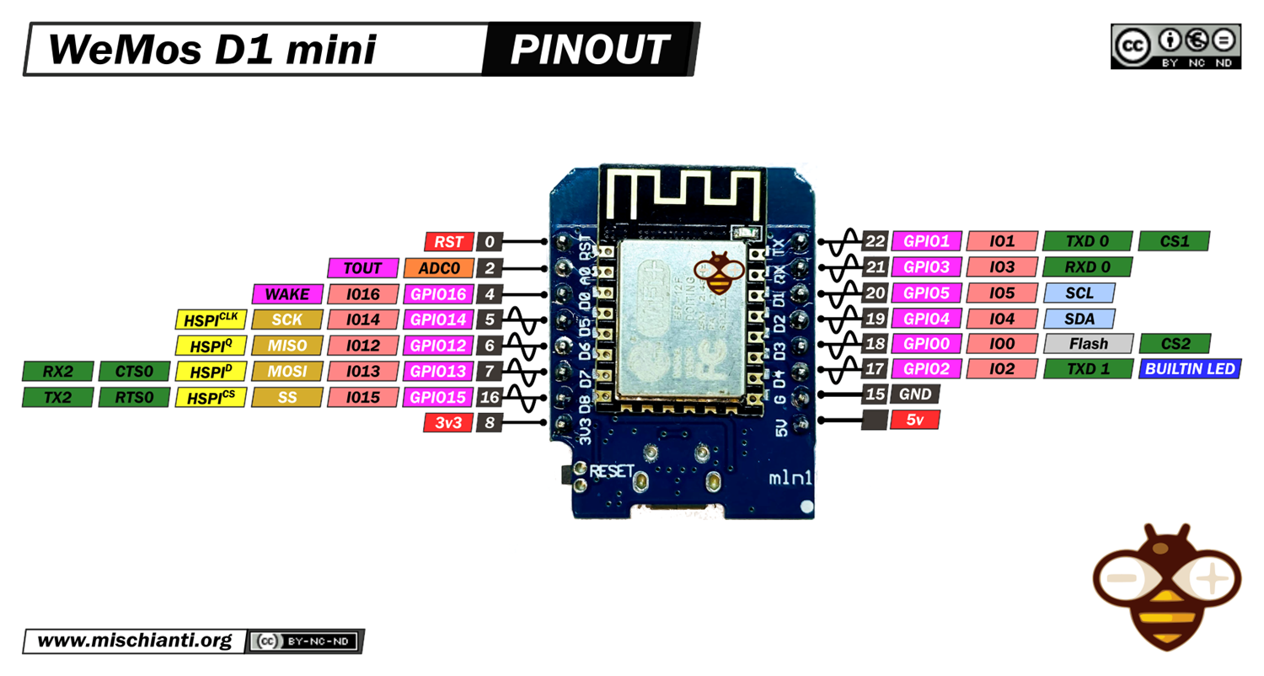
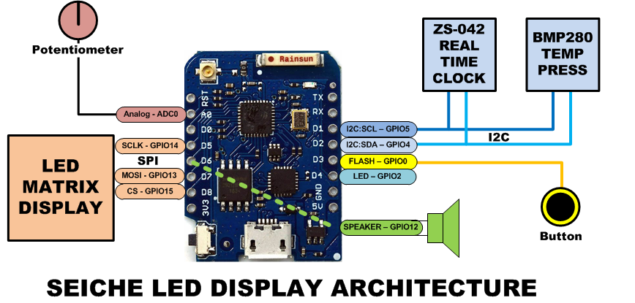
LESSON REFERENCE

Slide 22
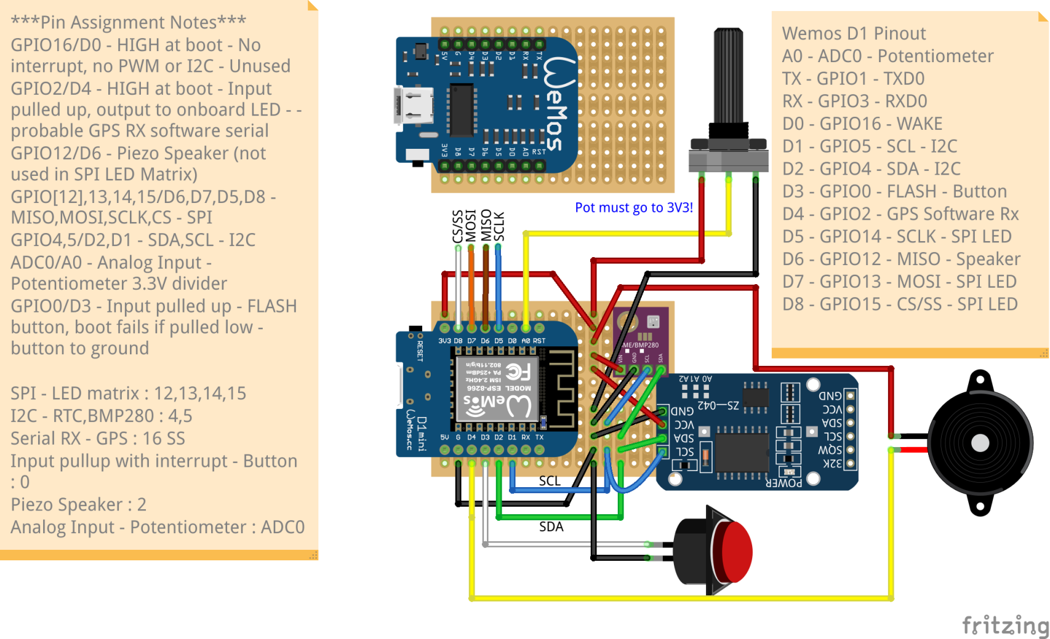
LESSON REFERENCE

